Slide 1

6th International Conference on
Natural Science and Technology
(ICNST 19)
29 – 30 March, 2019
Paper ID # O.ICT.004.
A Model For Structuring Unstructured Data From Email In The Context Of Big Data
Presenting By:
Monisha Chowdhury, Afra Anjum Anika, Johir Khan Babor
Affiliations : Computer Science and Engineering,
Metropolitan University
Bangladesh
Date: 29st March 2019

Slide 2
Paper Outline
1
Introduction
Problem Definition
Related Works
Proposed Methodology
Results & Discussions
Conclusion
Future Scope
References

Slide 3
Introduction
2
Internet of Things(IoT) – A network of embedded devices.
Big Data - An enormous quantity of different types of data.
Produced by high-performance heterogeneous group of applications.
Consists of Structured, Semi-structured and Unstructured data.
Structured data has predefined format.
Unstructured data is not in organized form.
Semi-structured data contains characteristics of both structured and unstructured data.

Slide 4
Introduction
2
Separating structured, Semi-structured and Unstructured data is time consuming.
80% of data that are generated is unstructured.
Disadvantage of unstructured data:
Need more space to store.
Complex querying.
Important Information locked up.
Data visualization and uncovering insight from unstructured data is important to get the most out of the data.

Slide 5
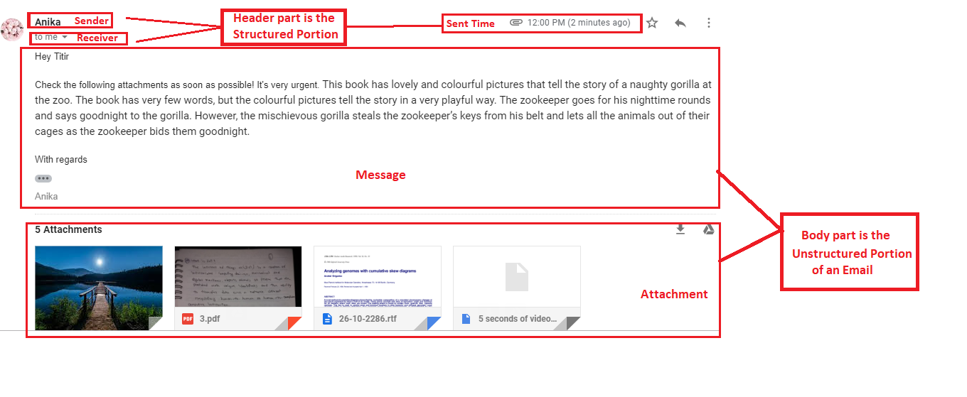
Problem Definition
4
Fig: Different parts of an Email

Slide 6
Problem Definition
4
A several work has been done on the text portion of an email.
Most of the work mainly focused on text cleaning.
Attachment portion has been ignored.
No particular model found for structuring the attachment portion of email.

Slide 7
Related Works
3
Author Name | Paper Title | Contribution | Limitation
Abhay Kumar Bhadani, Dhanya Jothimani | Big Data: Challenges, Opportunities and Realities[1]. | Mentioned limitations like scalability and storage issues of analyzing unstructured data. | Did not introduce any specific solution for these limitations.
Min Chen , Shiwen Mao, Yunhao Liu | Big Data: A Survey[2]. | Examine some application of big data. Point out some technical changes in the traditional data analysis methods and tools for big data analytics. | Managing big data properly was not included in this work.
Marjani, M., Nasaruddin, F., Gani, A., Karim, A., Hashem, I.A.T., Siddiqa, A. and Yaqoob, I. | Big IoT Data Analytics: Architecture, Opportunities, and Open Research Challenges[3]. | Proposed architecture for big data analytics. Found out some challenges in privacy, data mining, visualization, and integration. Found out the synchronization issues in parallel computing. | No model for the analyzed issues has been proposed by the author.
Jie Tang, Hang Li, Yunbo Cao, Zhaohui Tang | Email Data Cleaning[4]. | Focuses mainly on cleaning the text portion of the email. Used non-text filtering and normalization on the basis of Support Vector Machine (SVM). | Basically, they work on cleaning data and completely ignoring the attachment part which is also a major source of information.

Slide 8
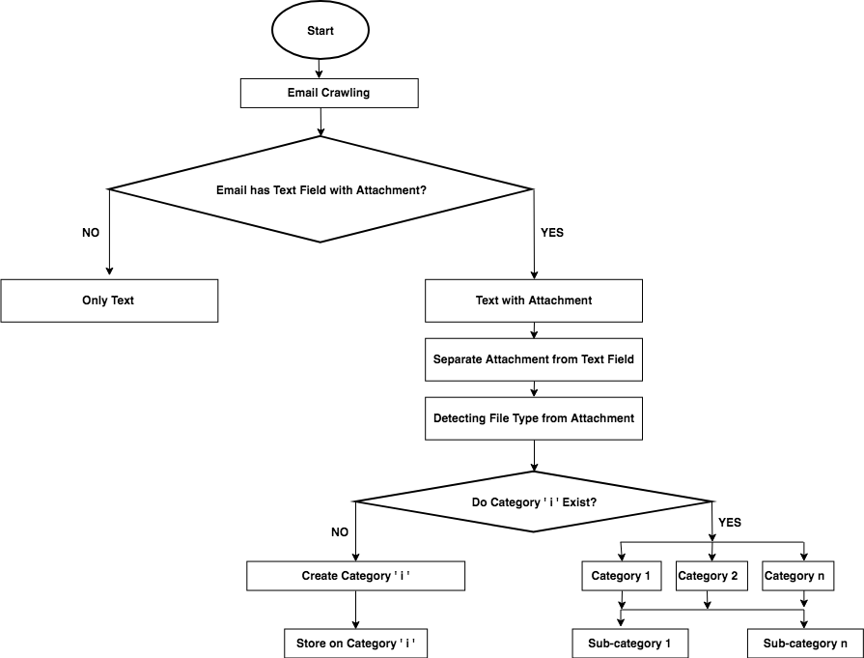
Proposed Methodology
5
Fig: Flowchart of Proposed Methodology

Slide 9
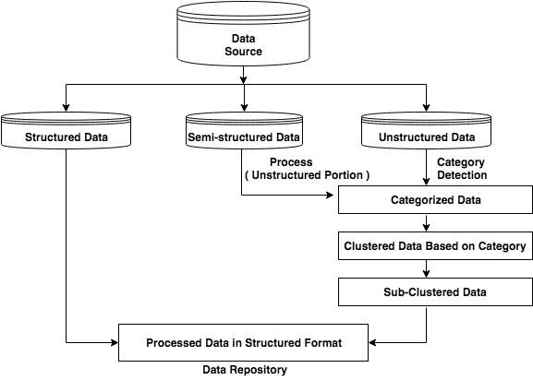
System Architecture
5
Consists all kinds of data
Contain data that follows protocol
Contain data that poses feature from both types of data
Comprise data that has no internal structure
Detect category of data
Cluster categorized data
Sub-clustered data based on its attribute
Allocate different room for each sub-clustered data
Fig: Proposed System Architecture

Slide 10
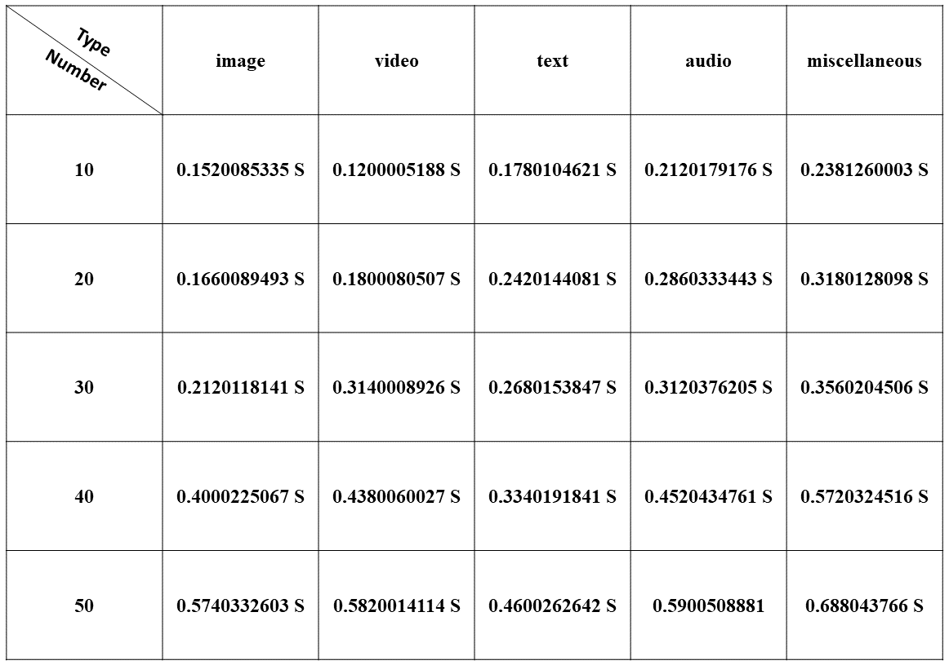
Experimental Analysis
6
Used standard python development environment called JetBrains PyCharm (2018.3.3)
Used a maximum of 50 unstructured data (attachment) in per email.
Fig: Required data separation time

Slide 11
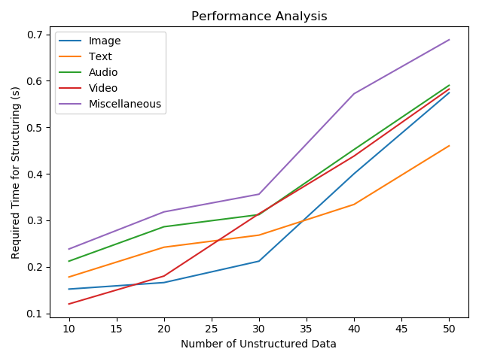
Results
6
Fig: Output of Separation time

Slide 12
Conclusion
7
Separate data from personal Email.
Size limitation of data.
Limitation of proper tool.

Slide 13
Future Scope
8
Deal with large data size.
For a realistic analysis, our proposed system can be implemented for any organization as server-based email service system which can be considered as an extended work

Slide 14
References
9
Bhadani, A.K. and Jothimani, D., 2016. Big data: challenges, opportunities, and realities. In Effective Big Data management and opportunities for implementation (pp. 1-24). IGI Global.
2. Chen, M., Mao, S. and Liu, Y., 2014. Big data: A survey. Mobile networks and applications, 19(2), pp.171-209.
3. Marjani, M., Nasaruddin, F., Gani, A., Karim, A., Hashem, I.A.T., Siddiqa, A. and Yaqoob, I., 2017. Big IoT data analytics: architecture, opportunities, and open research challenges. IEEE Access, 5, pp.5247-5261.
4. Tang, J., Li, H., Cao, Y. and Tang, Z., 2005, August. Email data cleaning. In Proceedings of the eleventh ACM SIGKDD international conference on Knowledge discovery in data mining (pp. 489-498). ACM.

Slide 15
9
Thank you

Slide 16
9
Any Questions?

